Slide 1
An Introduction To Pythons
Chris Life
Notes:
Introduce myself
After Lindsey’s session on accessibility yesterday I tried to make sure I used good contrast making this
When I heard about this conference I was really excited that Vancouver was hosting a conference dedicated to Pythons
When I was first learning to work with Pythons there were many basics I wish I’d had better explained, so I thought we could dive back to the basics together

Slide 2
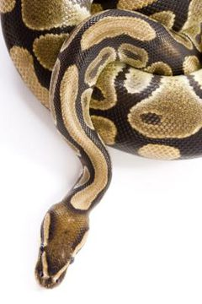
Concepts:
Syntax
Typing
Bytecode
Concurrency
Chris Life
Notes:
Don’t worry, I could see a few of you out there grinding your teeth as I said, ‘Pythons’ over and over.
I will be covering quickly a few very basic concepts relating to Pythons:
Syntax
Typing
Memory management
Concurrency

Slide 3
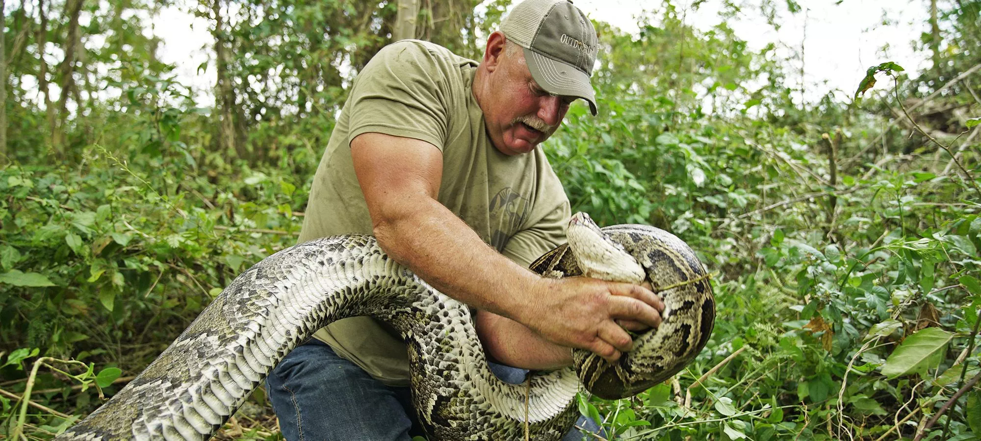
Syntax
White space
Critical with Pythons and will bite you if you aren’t careful
loop = {"I've had it with",
"these snakes, on",
"this plane!"} for item in loop: print item
Chris Life
Notes:
If you don’t pay proper attention to spacing when working with Pythons, you will probably get bitten
Happens to many people who are new to Pythons, but it only takes once or twice before they learn
What is he doing, not respecting spacing, he should be more careful

Slide 4
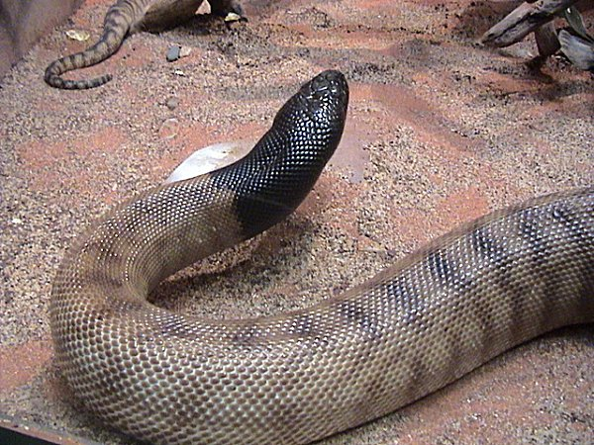
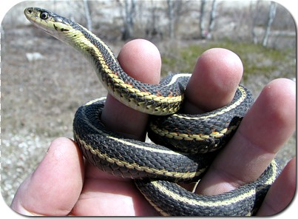
Typing
It is important to understand the type that you’re working with
Dynamically typed
(Variable) names are bound to objects at execution time
Chris Life
Notes:
Static and dynamic types are very different, and if you’re expecting one but get the other, you’re in for a nasty surprise, but once you identify the type you’re working with, it’s smooth sailing
Pythons are very dynamic types, one second they are doing one thing, relaxing maybe, and then next they are doing something completely different
And without getting too graphic that does sound like Python’s typical meal arrangements

Slide 5
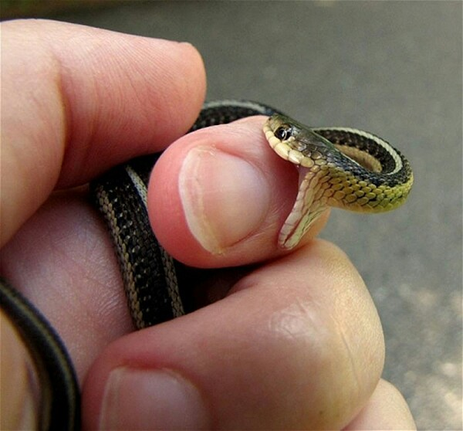
Bytecode
Generated by the Python interpreter at execution time
You can actually turn this off
export PYTHONDONTWRITEBYTECODE=1
Chris Life
Notes:
Ok, I’m sorry, this one was a low-hanging fruit and I was running out of jokes by this slide
As far as I can tell this doesn’t work with the snakes, no matter how many times I try, but I wish I had known that before the first time I accidentally committed a bunch of bytecode into a project repo. Lost commit privileges real fast after that one

Slide 6
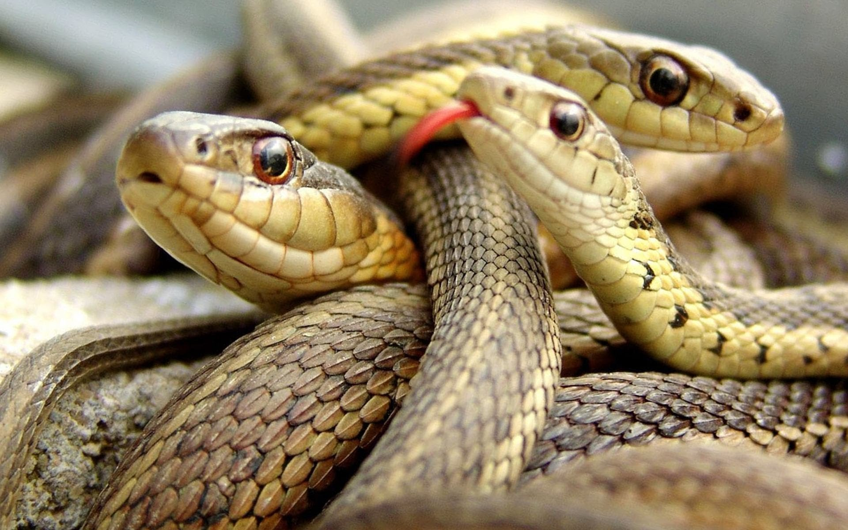
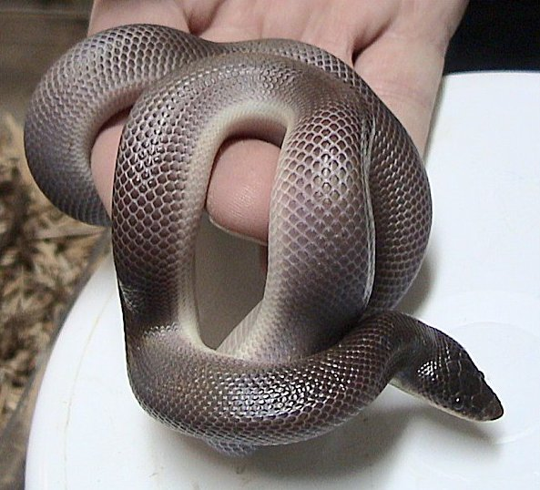
Concurrency
Working with multiple Pythons at once is difficult
GIL (Global Irate Loxocemus)
Loxocemus
Notes:
You should really be careful working with multiple Pythons at once
Key to first master working with one Python
Can accomplish a lot with multiple Pythons
GIL - that’s a type of snake - constructing that backronym was really difficult

Slide 7
Conclusion
Thankyou for sitting through my hammy jokes, I hope the mental anguish isn’t too terrible
I don’t have any online personas to link you to, sorry. Probably don’t find me on Facebook, definitely don’t find me on Snapchat
Chris Life

